Slide 1
Data and Safety Monitoring Committees in Clinical Trials
Denise J. Roe, DrPH
Mel and Enid Zuckerman College of Public Health
The University of Arizona Cancer Center

Slide 2
Outline
Introduction to role of DSMC
Multi-site NCI funded Selenium Trial – Study accrual and safety
SELECT Study – Example of early termination of a study

Slide 3
When are DSMCs needed?
(Ellenberg, Fleming, DeMets)
Is the trial intended to provide definitive information about effectivness and/or safety of a medical intervention?
Are there prior data to suggest that the intervention has the potential to induce potentially unacceptable toxicity?
Is the trial evaluating mortality or another major endpoint, such that inferiority of one treatment arm has safety as well as effectiveness implications?
Would it be ethically important for the trial to stop early if the primary question addressed has been definitively answered?

Slide 4
Fundamental Principles of Data Monitoring
Primary responsibilities are:
  Safeguard the interests of study patients
  Preserve the integrity and credibility of the trial so that future patients may be treated optimally
  Ensure that definitive and reliable results be available in a timely way

Slide 5
Fundamental Principles of Data Monitoring
DSMC should have multidisciplinary representation
  Physicians from relevant medical specialties
  Biostatisticians
  Patients or community members

Slide 6
Fundamental Principles of Data Monitoring
DMSC should have membership limited to individuals free of apparent significant conflicts of interest, whether they be financial, intellectual, professional or regulatory in nature

Slide 7
Fundamental Principles of Data Monitoring
The DSMC members should ideally be the only individuals to whom the data analysis center provides results on relative efficacy and safety of study treatments as the trial is ongoing

Slide 8
Meeting Format
Open session with the study investigators
Closed session which includes the DSMC members, study statistician(s), and someone to take notes
Open debriefing session with the investigators

Slide 9
Materials Made Available
Agenda
Open session report
  Collapsed across treatments
  Accrual, endpoint assessment, toxicities, serious adverse events
Listing of protocol deviations
Details on any Serious Adverse Events

Slide 10
Materials Made Available
Confidential closed session report
  Stratified by treatment
  Accrual, endpoint assessment, toxicities, serious adverse events

Slide 11
Serious Adverse Events
Death
Life-threatening
Requires hospitalization or prolongation of existing hospitalization
Results in persistent or significant disability or incapacity
Consists of a congenital anomaly or birth defect

Slide 12
Serious Adverse Events
Study related or unrelated
  Occurred while participant was on treatment or shortly thereafter
  Based on expected toxicities and potential toxicities which occurred in similar classes of agents
  Expected study related events are listed in the informed consent document

Slide 13
Serious Adverse Events
Whether or not it is study related may depend on the timing
  Sulindac study in breast cancer survivors being treated with aromatase inhibitors
  Due to funding constraints, three month observation period (with scans at the beginning and the end) then six month treatment period (scans at 3 months and 6 months)

Slide 14
Serious Adverse Events
In the initial DSMC meeting, members asked that future closed session reports include events occurring in:
  Observation period
  Sulindac treatment
  Both observation period and Sulindac treatment

Slide 15
Serious Adverse Events
GI symptoms are expected so DSMC recommended developing a standard protocol for managing them
  If the study is positive it would be part of the design of the subsequent randomized trial

Slide 16
Serious Adverse Events
Reported to Institutional Review Board
  Serious, related, unexpected (not in the consent form)
Reported to the sponsor
  Pharmaceutical company
  NCI or NIH
Reported to the DSMB within a specified time period

Slide 17
Selenium Trial
Design and Baseline Characteristics of Participants in a Phase III Randomized Trial of Celecoxib and Selenium for Colorectal Adenoma Prevention
Thompson P, Roe, DJ, Fales L, et al.
Cancer Prevention Research 5:1381-1393, 2012

Slide 18
The Selenium Trial
Initiated in November 2001
1621 individuals with a previous adenomatous polyp
Randomized to celecoxib (400 mg daily) and/or selenium (200 μg daily as selenized yeast) or double placebo in a factorial design
Primary trial endpoint is adenoma recurrence (3 to 5 years after baseline)

Slide 19
The Selenium Trial
Celecoxib arm was discontinued in December 2004 following reports of cardiovascular toxicity (824 individuals randomized)
Accrual continued with randomization to selenium alone versus placebo
Randomization of the original cohort completed in November 2008

Slide 20
The Selenium Trial
An additional 200 patients with one or more advanced adenomas were accrued to enhance statistical power in this higher-risk subgroup
Accrual of the total cohort (1824) completed in January 2011
Final follow-up completed as of January 2014

Slide 21
DSMB in the Selenium Trial
Ross Prentice, PhD (Biostatistician) – Chair
Jeffrey Borer, MD (Clinician)
Edward Giovannucci, MD, ScD (Epidemiologist)
David Ransohoff, MD (Clinician)
Linda Hicks (Patient advocate)

Slide 22
DSMB in the Selenium Trial
Met every 6 months since study initiation via conference call
Agenda, open and closed session reports sent at least a week before the meeting

Slide 23
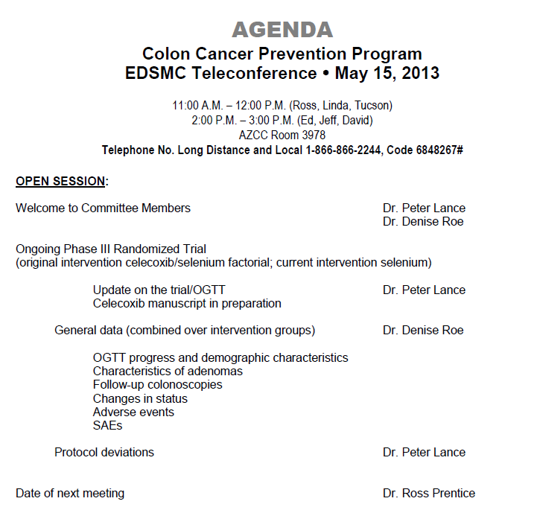

Slide 24
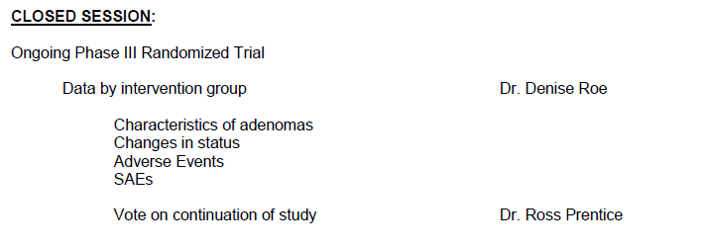

Slide 25
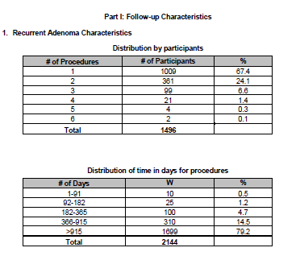
Follow-Up of Participants

Slide 26
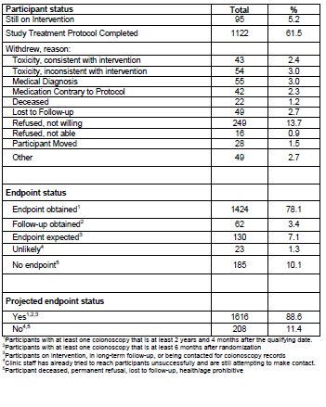

Slide 27
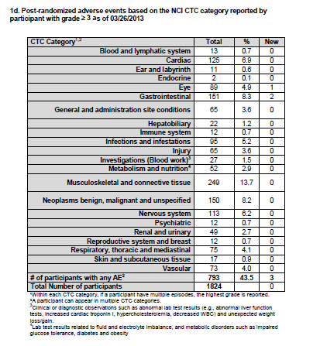

Slide 28
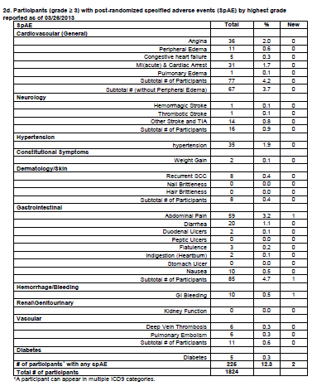

Slide 29
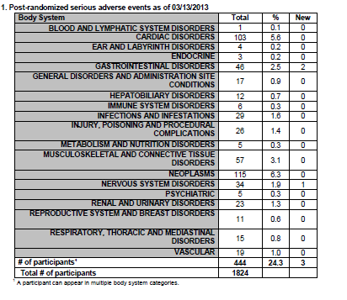

Slide 30
Scientific Advice from DSMB
The originally planned cohort of 1600 individuals included 25% who had an advanced adenoma at baseline
Considered to be of highest risk for progression to colorectal cancer
200 additional advanced adenoma participants were recruited based on the recommendation of the DSMB

Slide 31
Operational Aspects
Data closed for DSMB report a month before meeting
Open and closed session reports produced
Open session report shared with investigators before transmission to DSMB
Closed session report sent to DSMB by study statisticians
3 person weeks involved for each meeting

Slide 32
SELECT
Effect of Selenium and Vitamin E on Risk
of Prostate Cancer and Other Cancers:
The Selenium and Vitamin E Cancer Prevention Trial (SELECT)
Lippman SM, Klein EA, Goodman PJ, et al.
JAMA 301:39-51, 2009

Slide 33
SELECT
Objective: “To determine whether selenium, vitamin E, or both could prevent prostate cancer and other diseases with little or no toxicity in relatively healthy men.”
Eligibility requirements: “The major eligibility requirements included age 50 years or older for African American men and 55 years or older for all other men, no prior prostate cancer diagnosis, 4 ng/mL or less of PSA in serum, and a digital rectal examination (DRE) not suspicious for cancer.”

Slide 34
SELECT
Randomized, placebo-controlled, double-blind clinical trial
35,533 men from 427 participating sites
Selenium | Vitamin E
 | No | Yes
No | 8,696 | 8,737
Yes | 8,752 | 8,703

Slide 35
SELECT
Primary outcome measure was incidence of prostate cancer
Secondary outcomes included lung, colorectal, and overall primary cancer

Slide 36
SELECT
“All potentially eligible men were required to provide written informed consent before being allowed to participate in the trial.”
15 participants removed because their informed consent documents were not received

Slide 37
SELECT
“An independent data and safety monitoring committee met yearly and reviewed data on safety, adherence, and diagnosis of prostate cancer.”

Slide 38
SELECT
“In addition to the final analysis, interim analyses were planned for years 5, 7, 9, 10, and 11 after the first participant was randomized.”

Slide 39
SELECT
Planned follow-up was for at least 7 years with a maximum of 12 years
Supplement administration stopped early (after a median of 5.5 years)

Slide 40
SELECT
Hazard ratios and 99% CI for prostate cancer incidence:
Vitamin E: 1.13 (0.95 – 1.35; n = 473)
Selenium: 1.04 (0.87 – 1.24; n = 432)
Vitamin E + Selenium: 1.05 (0.88 – 1.25; n = 437)
Double placebo: 1.00 (n = 416)

Slide 41
SELECT
DSMC met for the second formal interim analysis
Recommended discontinuation of study supplements
“No evidence of benefit from either study agent was convincingly demonstrated (P<0.001) and there was no possibility of benefit to the planned degree with additional follow-up”

Slide 42
Summary
DSMC play a critical role in ensuring the integrity of scientific studies
Provide objective external view of study accrual, conduct, safety and results
Provide assurance to the investigators and the scientific community that study has been conducted with appropriate scientific rigor

